Slide 1
Geography – What would a journey through North America look like?
Week 1
North America – Countries
Locate North America on a world map and explore the landscape. To investigate and compare climates in North America.
LO: To name and locate countries of North America on a world map.
Week 2
North America – USA States
Locate the states of the USA on a map.
LO: to name and locate USA states.
Week 3
New York
Research information on New York
LO: to identify human and physical features and key characteristics of New York.
Week 4
Wonders of America
LO: to describe the characteristics and significance of a wonder of America.
LO: to identify human and physical features of the USA
Week 5
Comparing States
Compare the landscapes of different US states.
LO: to compare similarities and difference between states in the USA.
Week 6
Comparison Study
Compare the UK with a Region in North America
LO: to compare similarities and difference between UK and North America.
What will we be learning about over the coming weeks?

Slide 2
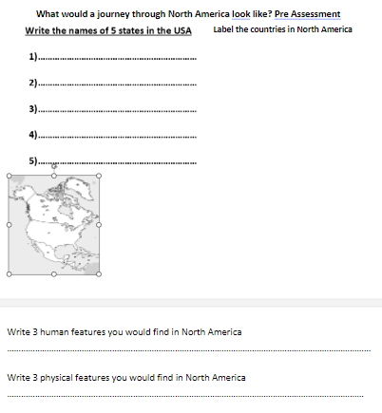
Pre assessment

Slide 3
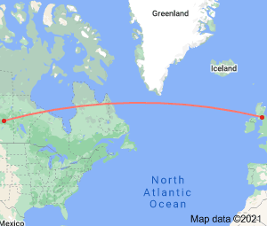
LO: To name and locate countries of North America on a world map.
How long do you think it would take to get to North America?
Which would be the quickest mode of transport?
Non-stop flights from London to New York takes anywhere between 8 hours to 10 hours
3,656 mi
Distance from United Kingdom to North America
Uk is located around 9560 KM away from Usa so if you travel at the consistent speed of 50 KM per hour you can reach Usa in 191.22 hours.
How long does it take to get to America by boat? You can expect to spend closer to six or seven days in transit, and sometimes longer.

Slide 4
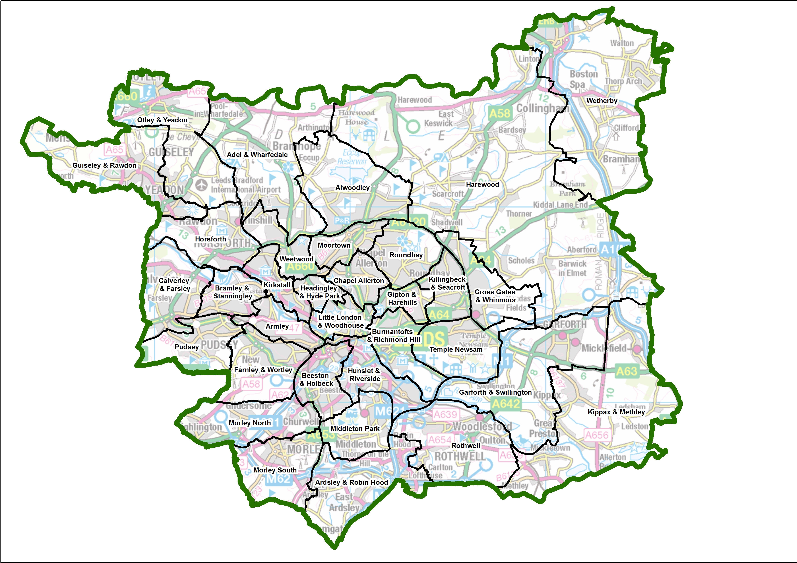
Where are we in Leeds?
Pudsey & Bramley

Slide 5
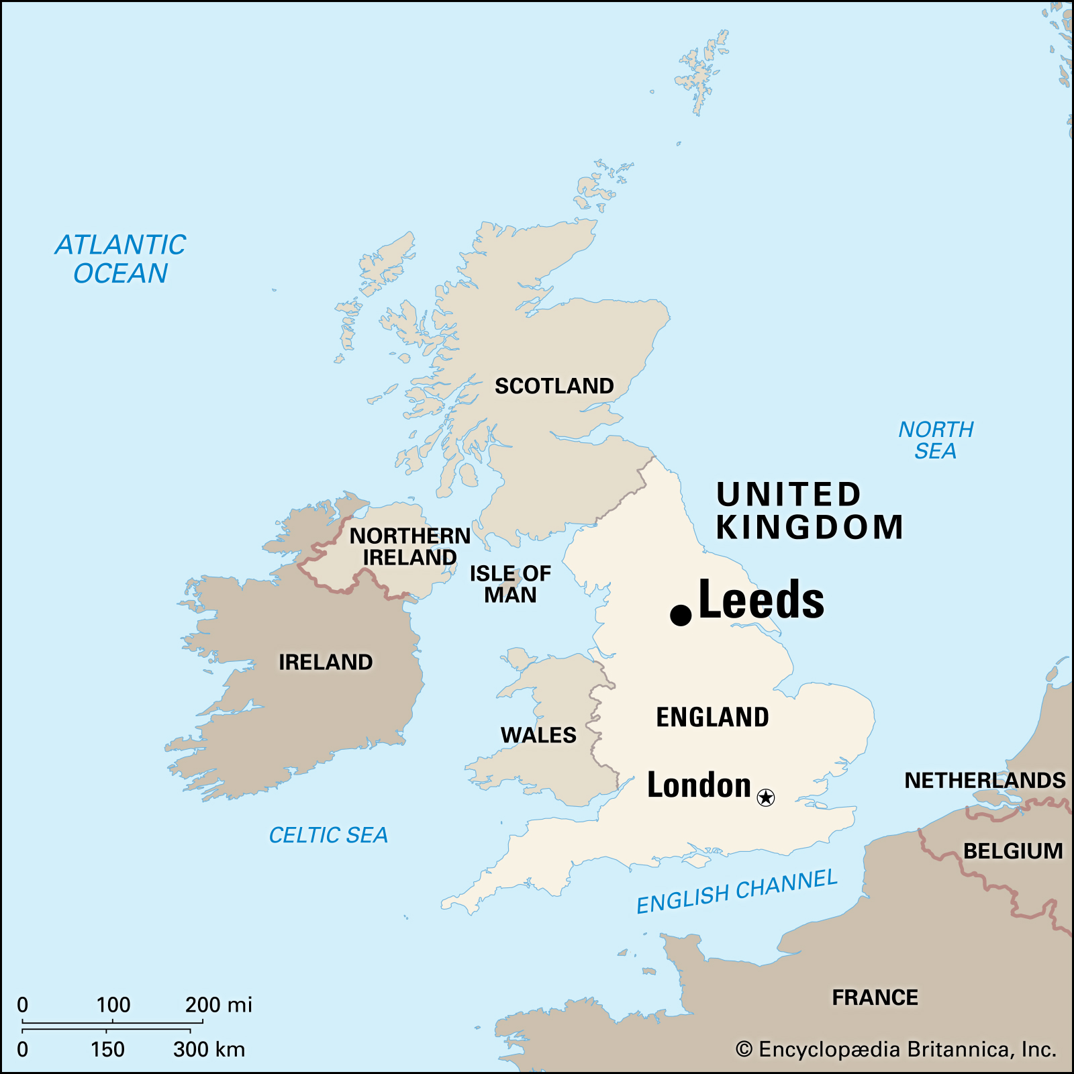
Where is Leeds in the UK?

Slide 6
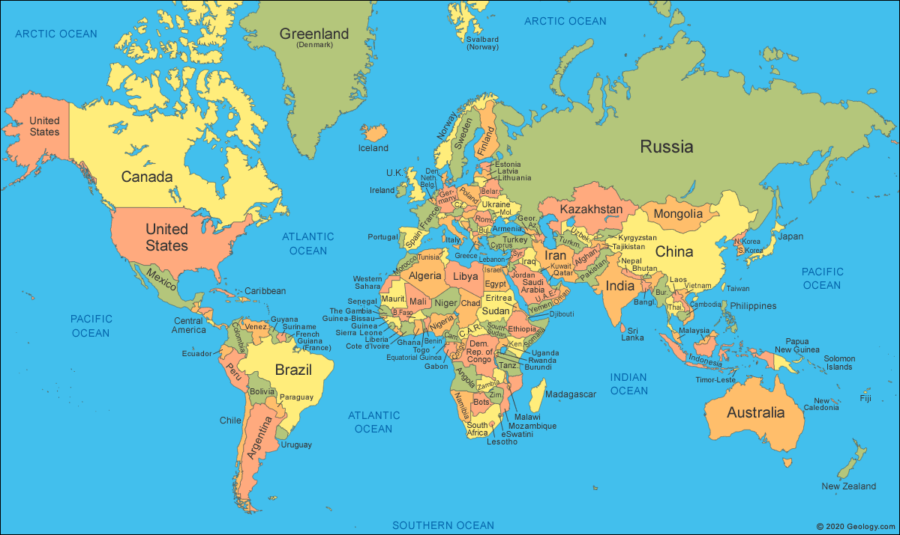
Where is the UK and North America?

Slide 7
What Is a Continent?
What continent is the UK found on?
What continent is the USA found on?
Here are the seven continents of Planet Earth. A continent is a massive piece of land that is often separated from other areas of land by water, or another feature, such as mountains.
Europe
Asia
North America
Africa
South America
Oceania
Antarctica

Slide 8
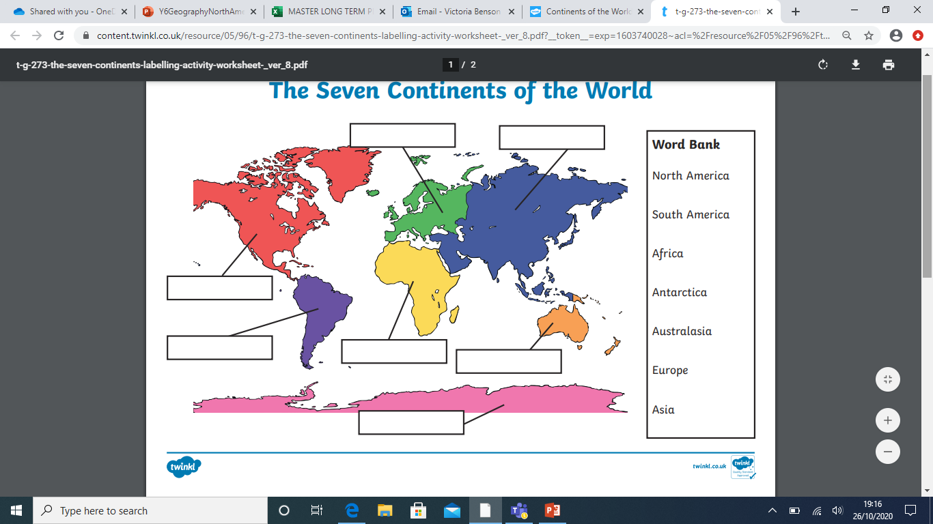
Task 1:Can you label the 7 continents of the world?
Can you label the UK and Leeds?

Slide 9
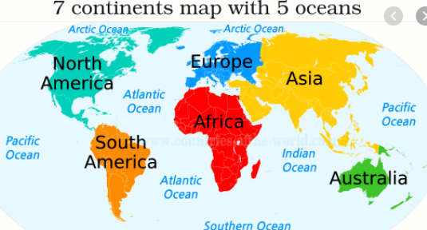
Green pens ready.
Can you label the UK and Leeds?

Slide 10
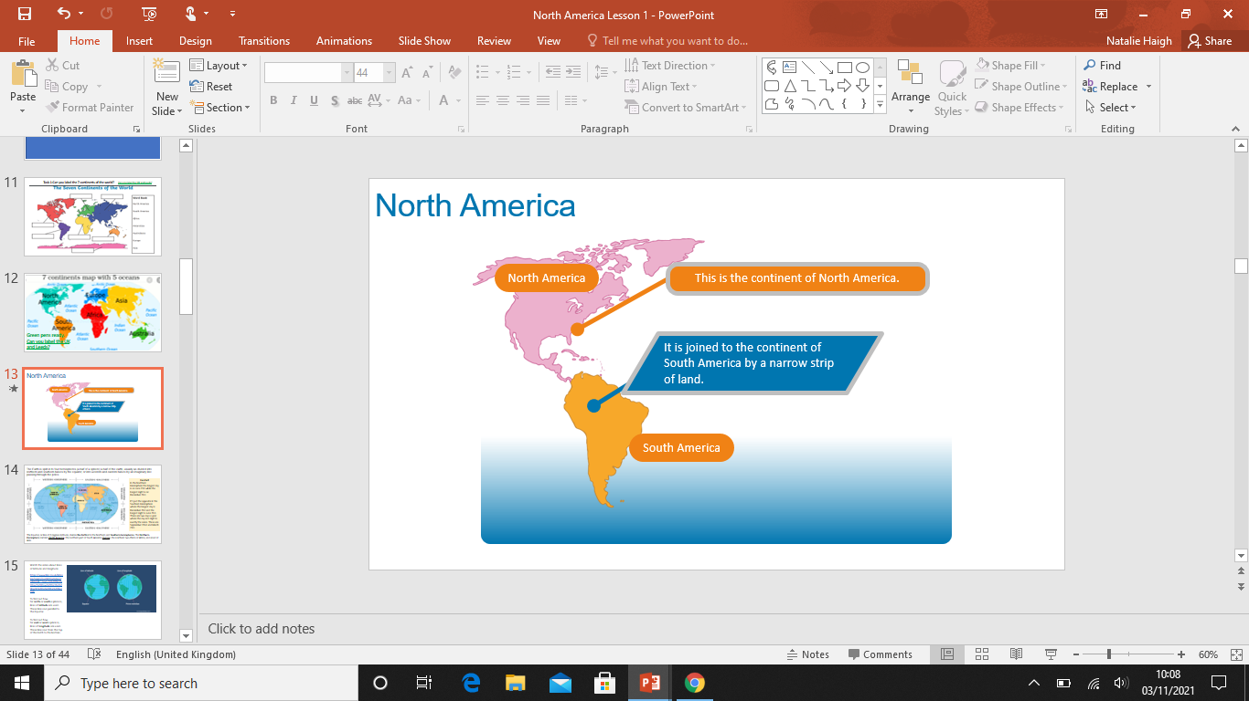
North America

Slide 11
North America
There are many countries that make up North America.

Slide 12
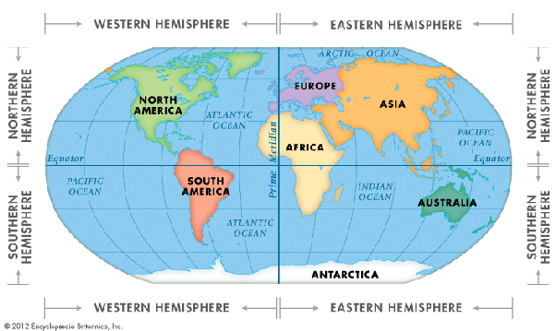
The Earth is split in to four hemispheres (a half of a sphere) a half of the earth, usually as divided into northern and southern halves by the equator, or into western and eastern halves by an imaginary line passing through the poles.
Fun Fact
In the Northern Hemisphere the longest day is on June 21st while the longest night is on December 21st.
It's just the opposite in the Southern Hemisphere where the longest day is December 21st and the longest night is June 21st.
There are two days a year where the day and night is exactly the same. These are September 22nd and March 21st.
The Equator, or line of 0 degrees latitude, divides the Earth into the Northern and Southern hemispheres. The Northern Hemisphere contains North America, the northern part of South America, Europe, the northern two-thirds of Africa, and most of Asia.

Slide 13
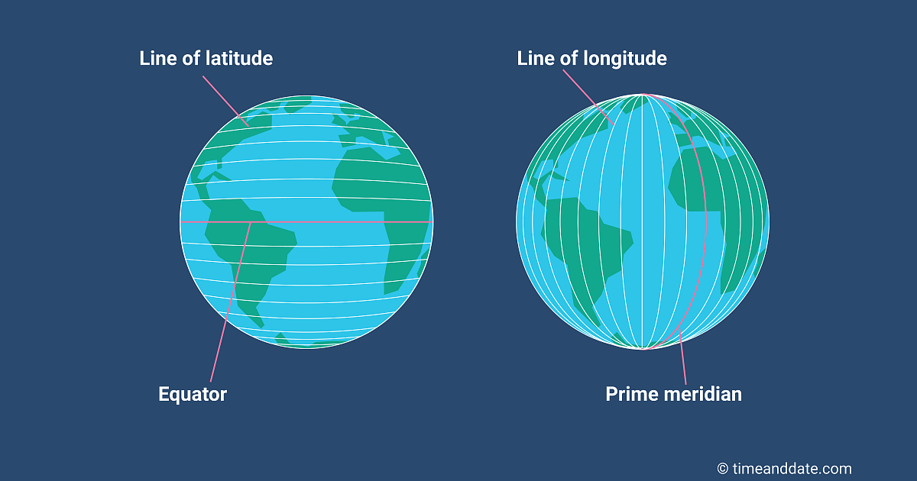
Watch the video about lines of latitude and longitude
https://www.bbc.co.uk/bitesize/topics/zvsfr82/articles/zd4rmfr#:~:text=To%20find%20out%20how%20far,the%20Earth%20to%20the%20bottom.
To find out how far north or south a place is, lines of latitude are used. These lines run parallel to the Equator.
To find out how far east or west a place is, lines of longitude are used. These lines run from the top of the Earth to the bottom.

Slide 14
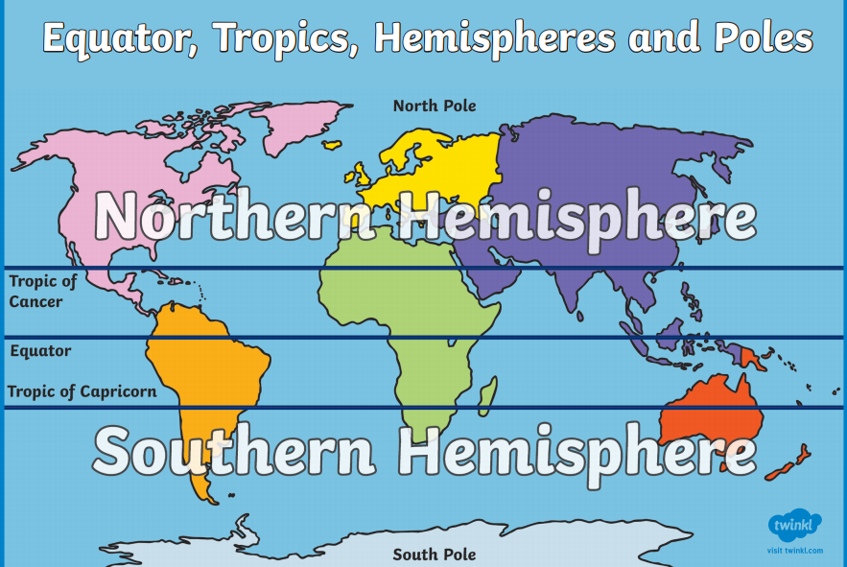
The region of Earth’s surface that is closest to the Equator is called the tropics.
Two imaginary lines that circle the globe mark the boundaries of the tropics.
The line called the Tropic of Cancer marks the northern edge.
The line called the Tropic of Capricorn marks the southern edge.

Slide 15
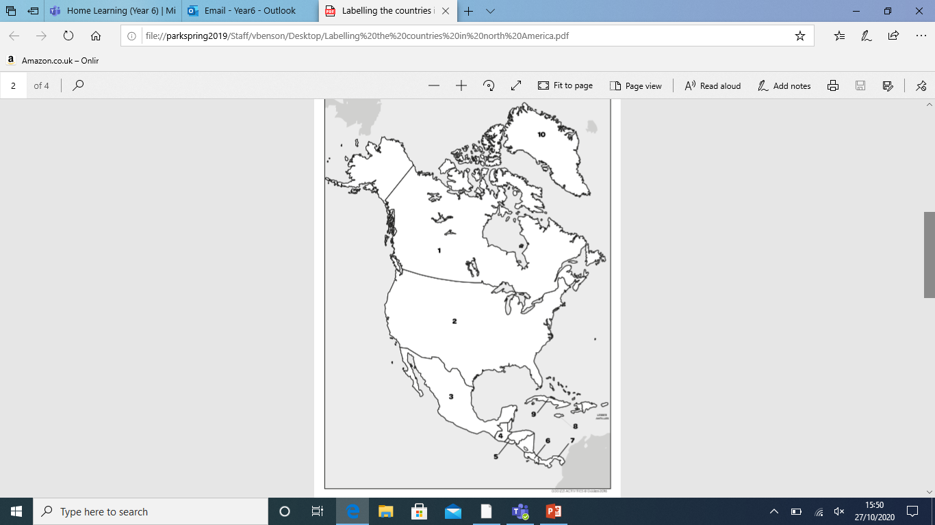
Task 2
In Pairs, use your ipad/ atlas to label all the countries in North America.
How many countries are there?

Slide 16
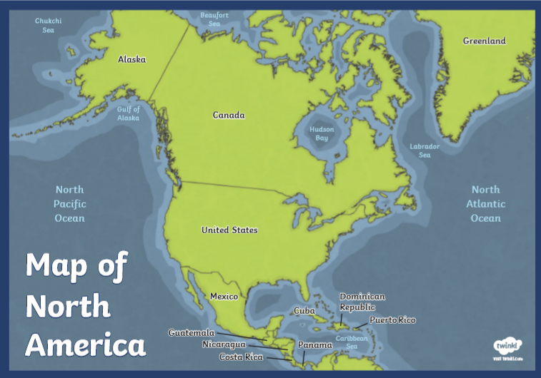
23 countries
The continent of North America is located in the Western Hemisphere and Northern Hemisphere and spans more than 24,709,000 km² (9,540,000 mi²).
There are 23 countries in North America, as well as more than two dozen non-sovereign territories, including Bermuda, Aruba, the Cayman Islands, Greenland, and Puerto Rico.

Slide 17
Task 3
In pairs, choose one of the countries below to research and make a poster/fact file on that country then present it to the rest of the class.
Canada
Mexico
Guatemala
Jamaica
Costa Rica
You must include:
Flag
population (how many people live there)
location (land boarders)
capital city
language
Food
celebrations

Slide 18
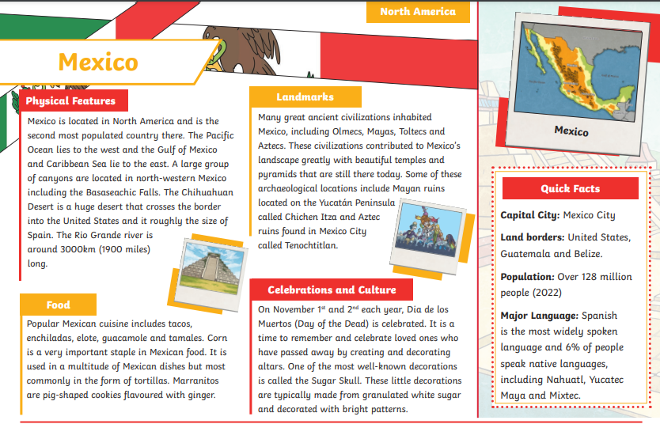

Slide 19

North America
How many countries on the continent of North America can you remember in one minute? Tell your partner.
Start Timer
0
59
58
57
56
55
54
53
52
51
50
49
48
47
46
45
44
43
42
41
40
39
38
37
36
35
34
33
32
31
30
29
28
27
26
25
24
23
22
21
20
19
18
17
16
15
14
13
12
11
10
9
8
7
6
5
4
3
2
1
60

