Slide 1
Design Technology –Year 6
Week 1
Activity :Decide on the type of vehicle you wish to make and the reason it needs an alarm.
L.O: Use market research to inform plans and ideas.
Designing
Week 2
Activity: Experiment with circuit making using a range of inputs, outputs and toggle devices.
LO: To use a range diagrams such as cross sectional.
LO: To understand and use electrical components in different types of circuits incorporating switches and buzzers.
Technical Knowledge
Week 3
Activity: Draw how you will make the circuit and how it will be hidden within the vehicle. Show hidden circuit inside the vehicle by drawing a cross sectional plan.
LO: To use a range of diagrams such as cross sectional.
Designing
Week 4
Activity: Edit design if needed to show you have considered the user in the design and then create vehicle shell.
LO: To use a finishing technique that involves a number of steps.
LO: To know how to use tools correctly and safely.
Making
Week 5
Activity: Finish creating the vehicle shell and then add the circuit.
LO: To select from a range of electrical components to make a working circuit.
LO: To know how to refine and improve designed products.
Making
W
Week 6
Activity: Evaluate each others finished products against design criteria, suggest improvements and test alarm systems.
LO: To evaluate their product against own clear design criteria.
LO: Know how products should be stored and give reason.
Evaluating
.
How could an alarm affect the safety of a vehicle?
What will we be learning about over the coming weeks?

Slide 2
Resource list
Dig out metal rulers, Stanley knives or the sharp scissors for scoring from the central DT cupboard.
rechargeable electricity hub and kit, alarms kit, switches (on the DT shelves – children DO NOT take home, put back on DT shelf when finished topic)
Vehicle nets
Correx, thick straws

Slide 3
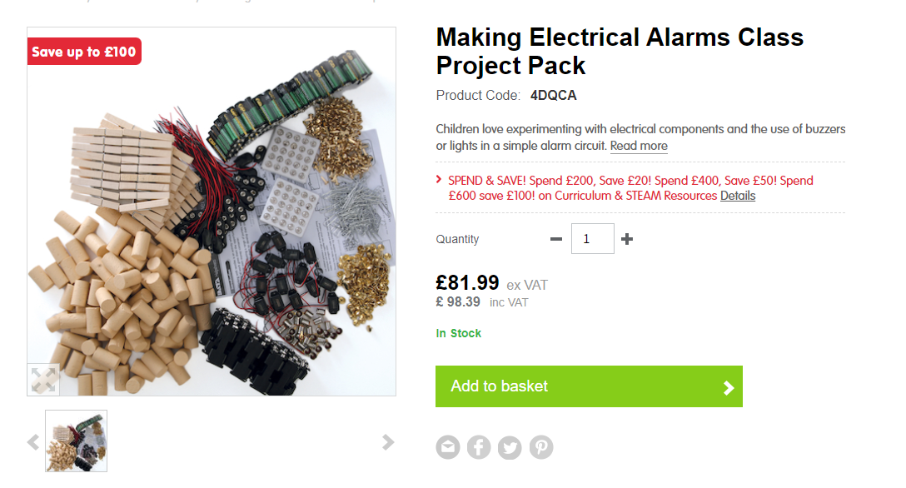
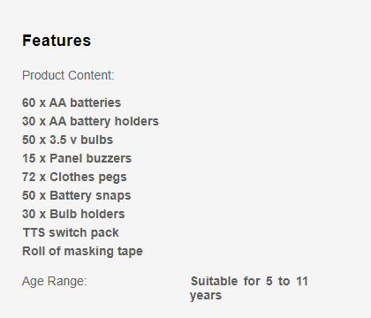
This kit was ordered previously – check resources that are left
Y5 have a vehicle kit ordered for them and may have some resources left for this topic – wheels etc. Please check in with them.

Slide 4
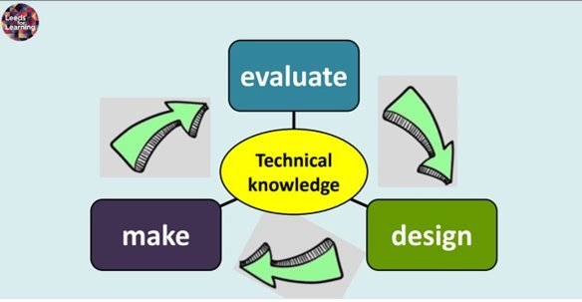
Design Technology process

Slide 5
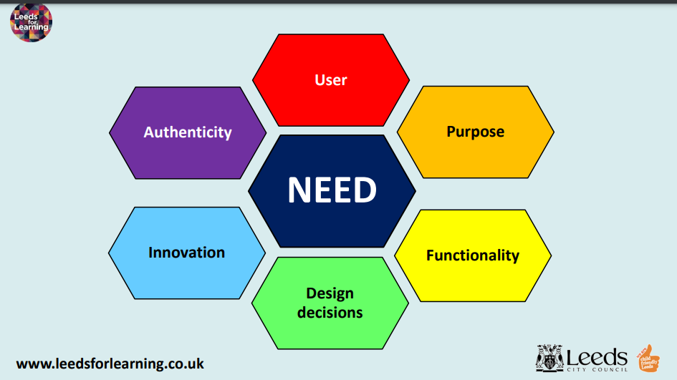
Design Technology Principles

Slide 6
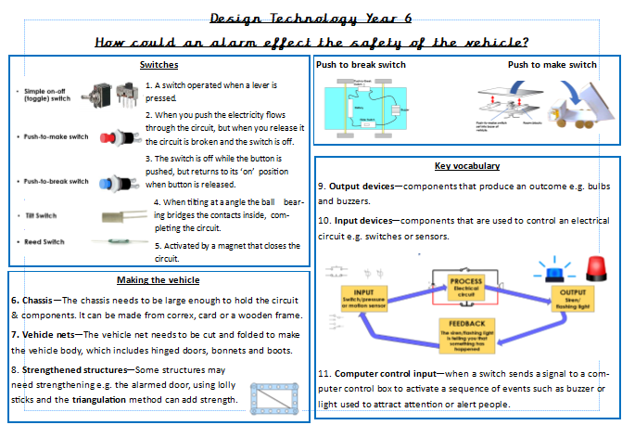

Slide 7

Previous learning – name a type of switch
Previous learning – name a type of fabric that is easy to use
What is the purpose of a 'push to break' switch?
What is cut and folded to make the vehicle body?
Name an input device
What can be used to alert or attract attention of people?

Slide 8
Six D&T Essentials
Have the needs of user(s) been identified and met (or has it been designed with no-one in mind)?
Does it have a clear purpose (or is it purposeless)?
Have design decisions been made (or has it been made to a prescribed formula)?
Would it work/function (or is it purely aesthetic/ornamental)?
Is the product innovative (or doesn’t it offer anything new/original/better)?
Is it an authentic product (or is it a model/gimmick)?

Slide 9
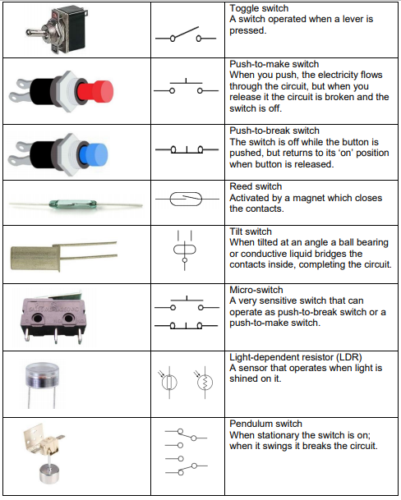
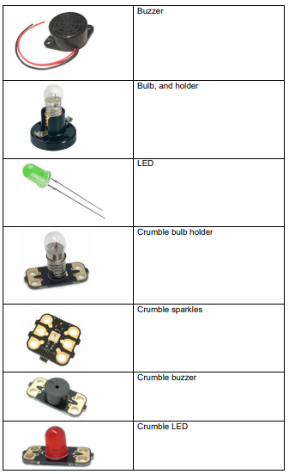
Vocabulary

Slide 10
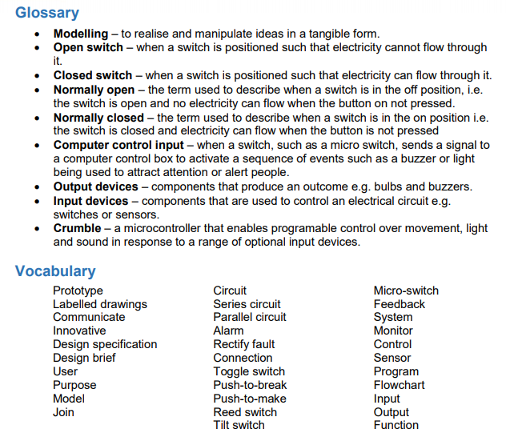
Vocabulary

Slide 11
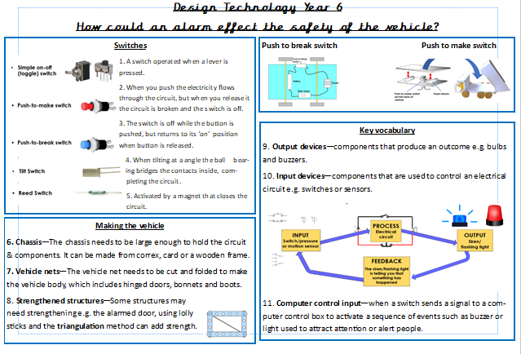
Lets refer to the knowledge organiser

Slide 12
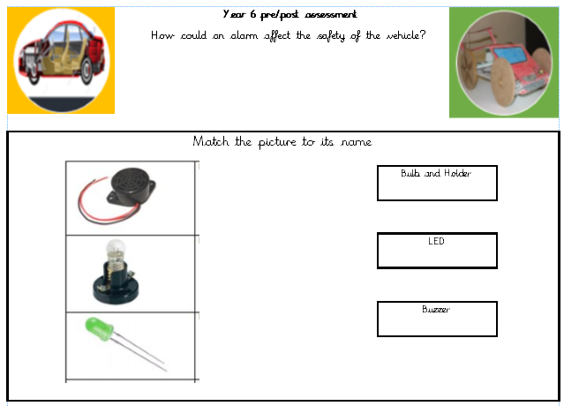
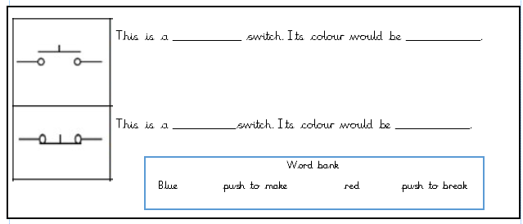

Let's complete the pre assessment
One drive
Curriculum 2020
End of unit low stake quizzes
Year 6

Slide 13
Lesson 1
LO: Use market research to inform plans and ideas.
1) Google types of vehicles – create a list of 10 in your DT books.

Slide 14
2) Discuss slides 8-12 to create ideas of other reasons a vehicle may need alarm except burglary.
Print slide 9 for children to have a go at.

Slide 15


Alarming Vehicles
Designing and making an electrical alarm system for a car or lorry

Slide 16
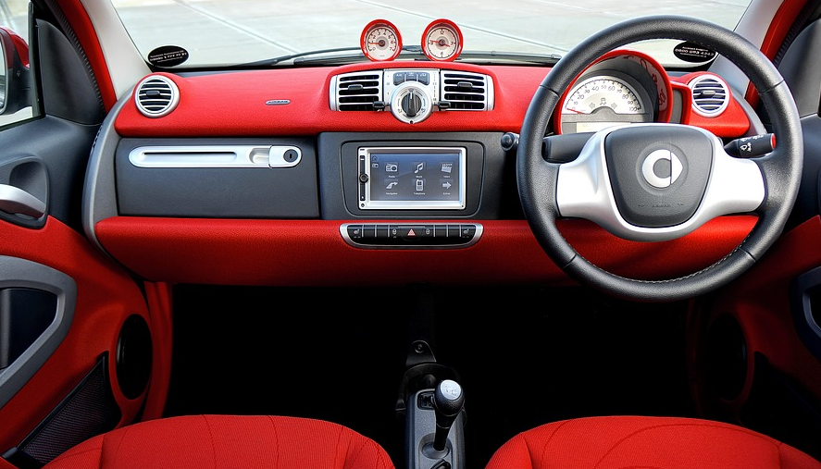
Design brief
Design and make an alarm that is suited to a type of vehicle of your choice.
Design criteria
It will need to:
Meet the needs of the vehicle user.
Use at least one motion/pressure sensor.
Be hidden from view.
Notes:
Image: Pixabay
See worksheet 1

Slide 17
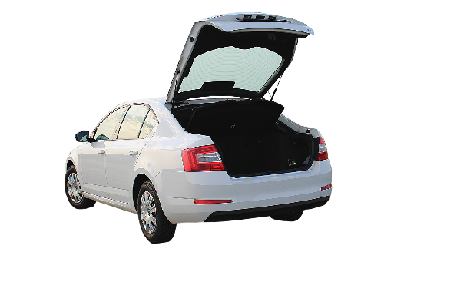
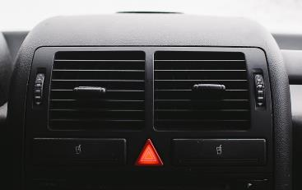
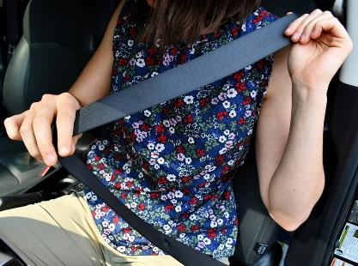
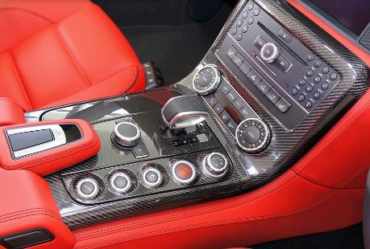
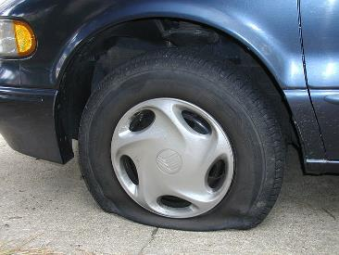
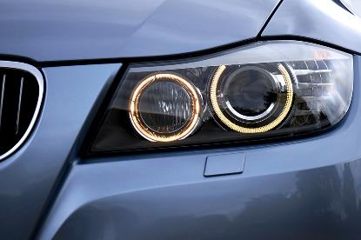

Print for children to answer on sheet in pairs
Vehicle alarm systems
What could be triggered when you open your boot?
What warning lights might you have on your dashboard?
How could an alarm help you remember to attach your seat belt?
How could switches help you automatically turn your lights on or off?
Can you think of a way a sensor might help you use your head lights, or warn you of a puncture?
Notes:
Images: Pixabay; Wikimedia

Slide 18

Needs of the user
What type of alarms might this vehicle’s user need?
This vehicle might need an alarm for.... because...

Slide 19

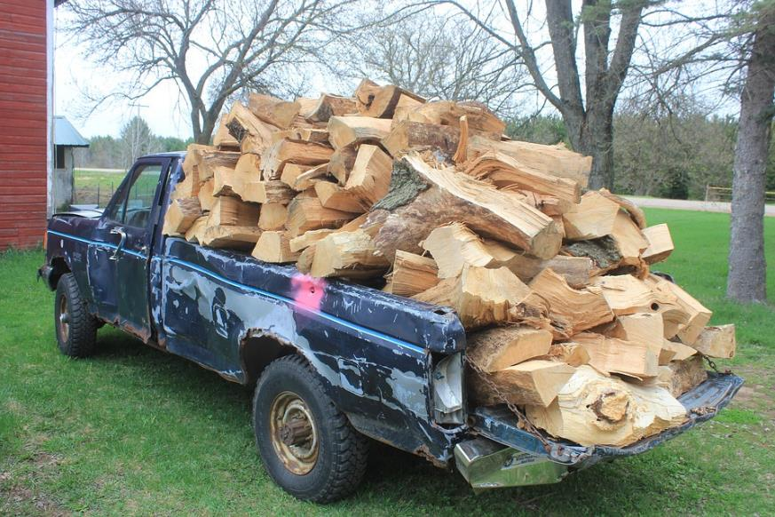
Needs of the user
What type of alarms might these vehicles and users need?
The user of this vehicle might need an alarm for.... because...
This vehicle might need an alarm for.... because...
Notes:
Images: Pixabay

Slide 20

Needs of the user
What type of alarms might this car and user need?
The user of this vehicle might need an alarm for.... because...
This vehicle might need an alarm for.... because...
Notes:
Image: Pixabay

Slide 21
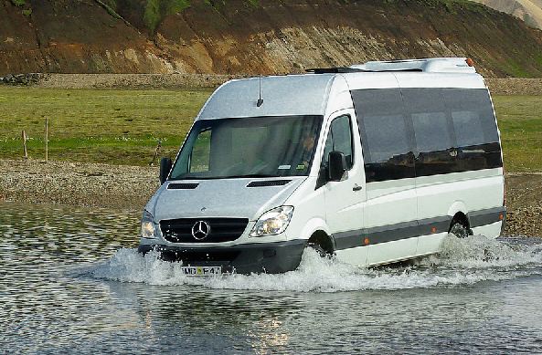
Needs of the user
What type of alarms might a minibus and users need?
The user of this vehicle might need an alarm for.... because...
This vehicle might need an alarm for.... because...
Notes:
Image: Pixabay

Slide 22
Week 1 –Ict suite / Ipads
Slide 14- activity
Add to their lists the type of the alarm each vehicle may find useful. e.g. van – weight limit reached.
Decide about the type of vehicle they would like to design.
Challenge- Google images of existing products to cut and stick into DT book.

Slide 23
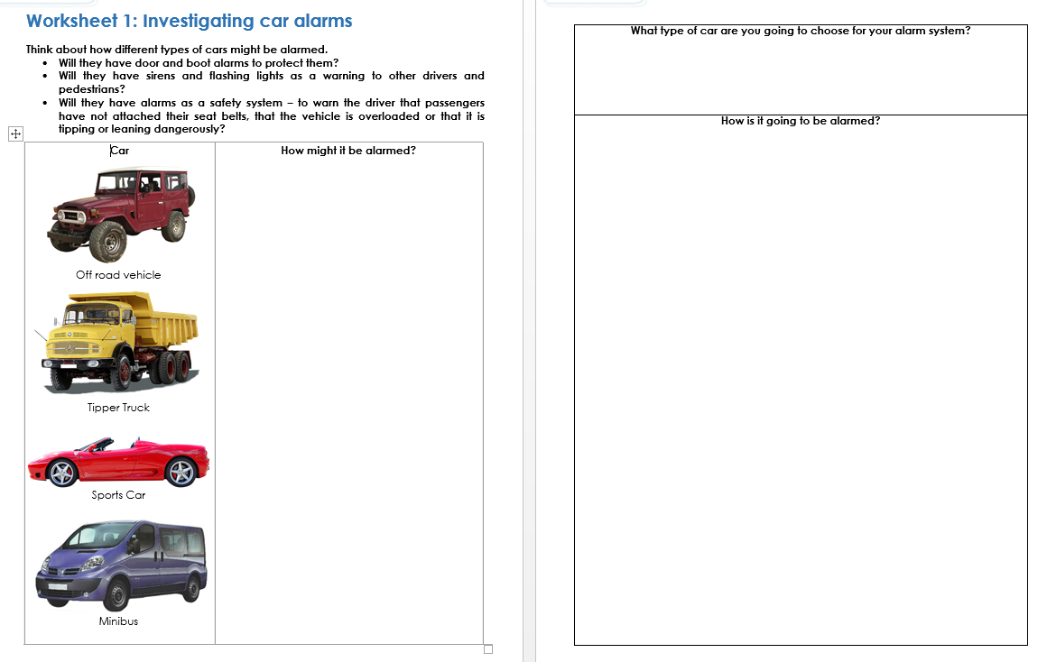

Slide 24
Bsquared sheet
This car might have an alarm for the following:
Circle your answer
boot door warn drivers
seatbelts overloaded
This off-road vehicle might have an alarm for the following:
Circle your answer
boot door warn drivers
seatbelts overloaded

Slide 25
This sports car might have an alarm for the following:​
Circle your answer​
boot door warn drivers​
​
seatbelts overloaded
Bsquared sheet
This minibus might have an alarm for the following:​​
Circle your answer​​
boot door warn drivers​​
​​
seatbelts overloaded

Slide 26
Bsquared sheet
I am going to choose a …..
It is going to be alarmed with …..

Slide 28
Week 2
LO: To understand and use electrical components in different types of circuits incorporating switches and buzzers.

Slide 29


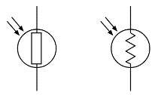


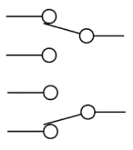

What is an alarm system?
PROCESS
Electrical
circuit
INPUT
Switch/pressure
or motion sensor
OUTPUT
Siren/
flashing light
FEEDBACK
The siren/flashing light is telling you that something has happened

Slide 30
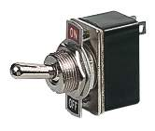

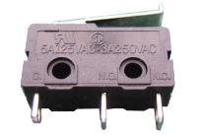
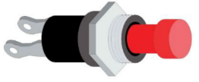
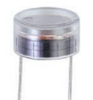
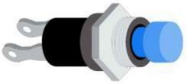
Switches and sensors
Simple on-off (toggle) switch
Micro-switch
Push-to-make switch
Light-dependent resistor (LDR)
Push-to-break switch
Notes:
See worksheets 2 & 3

Slide 31


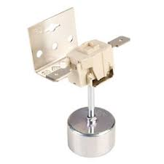


Motion sensor switches
Tilt Switch
Pendulum Switch
Reed Switch
Notes:
See worksheets 2 & 3

Slide 32
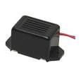
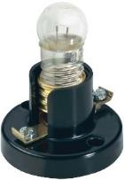

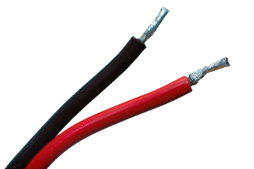
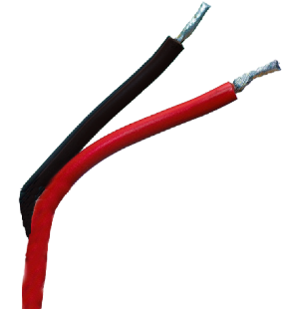
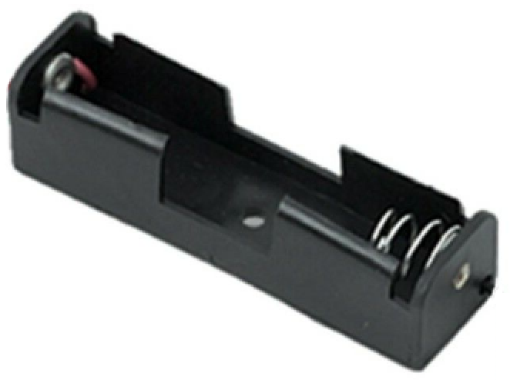
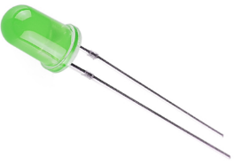
Circuits
Build a working circuit using a battery, switch and light or buzzer.
Put a different switch on each table and get the children to move around and have a go at making a circuit with each switch.

Slide 33
Switches and sensors
Micro-switch
Simple on-off (toggle) switch
Light-dependent resistor (LDR)
Push-to-make switch
Pendulum Switch
Push-to-break switch
Reed Switch
Tilt Switch
All children to have a go at drawing the switches and sensors in their DT books.
Notes:
See worksheets 2 & 3

Slide 34
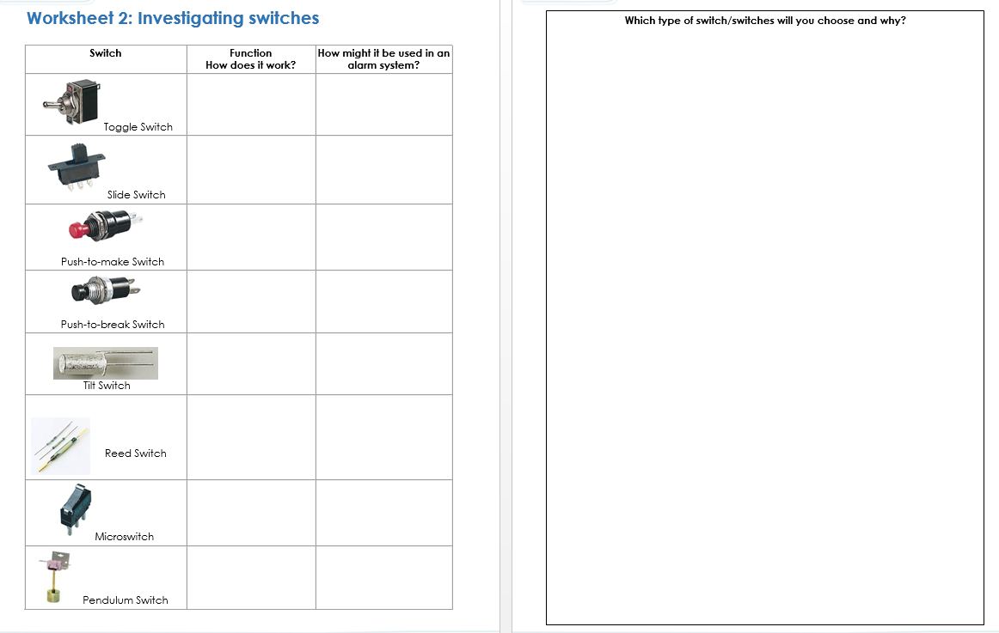

Slide 35
Week 2
LO: To understand and use electrical components in different types of circuits incorporating switches and buzzers.
Model the type of switch that will be used in the TES alarm system kit bought for the year group.
Can it be adapted ?

Slide 36
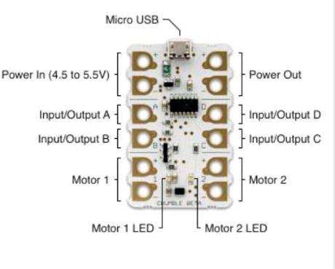
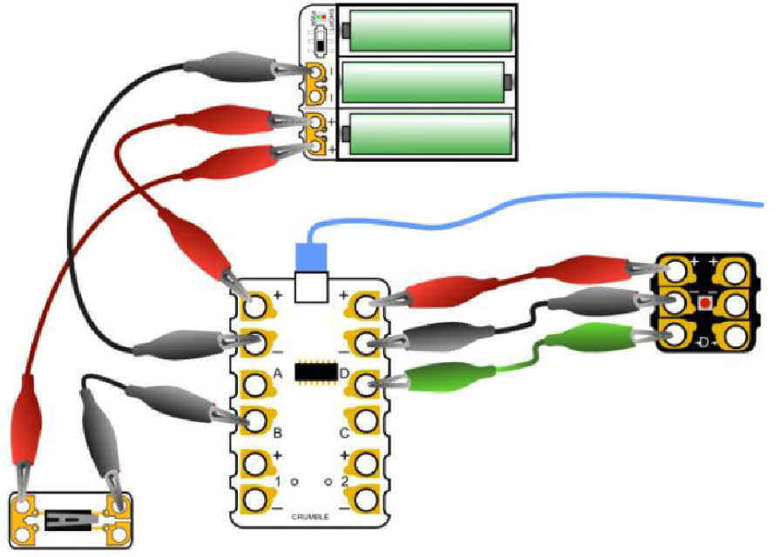
Programmable components
You might use a microcontroller such as a Crumble to control the inputs and outputs of your circuit.
With these you can use a range of switches and control the output by having your own sound and light response for a specified length of time.

Slide 37
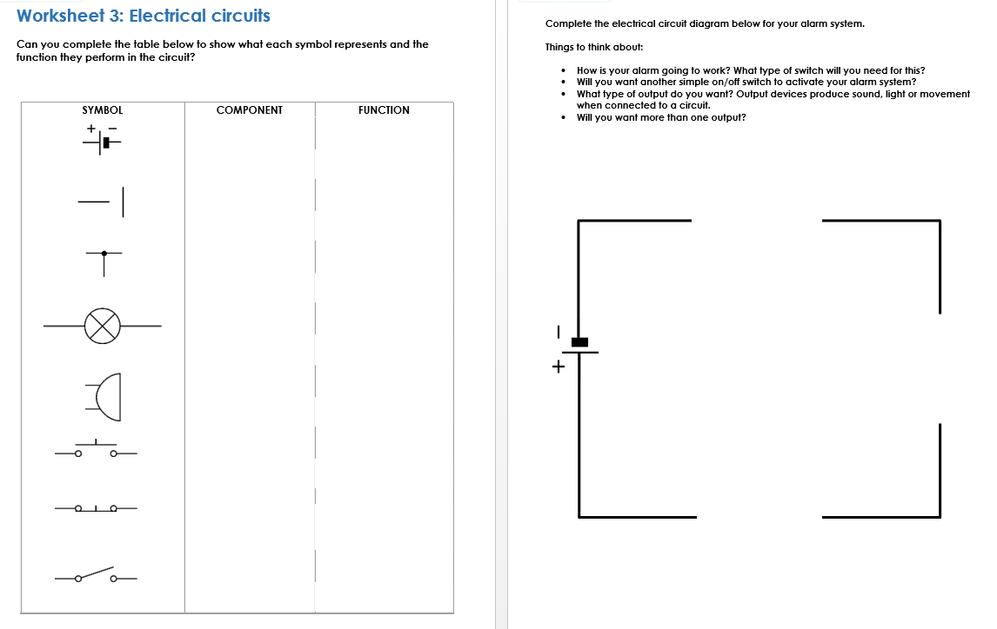

Slide 38
Circuit diagrams
Draw a circuit diagram of your design using correct symbols.
See worksheet 4.
Notes:
See worksheets 3 & 3.1

Slide 39


The electric circuit
Design your circuit using the appropriate inputs (switches) and outputs (light or buzzer).
Remember to include a toggle
(on-off) switch to activate and deactivate the circuit.
The circuit diagram shows the components and connections but not the actual layout.
On/Off Switch
_
Battery
Buzzer
Switch/Sensor

Slide 41
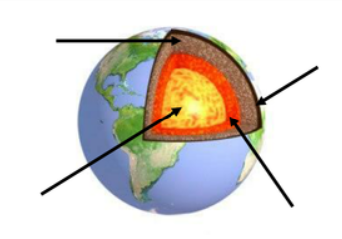
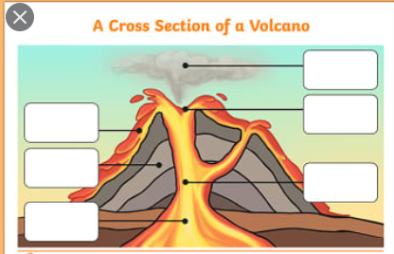
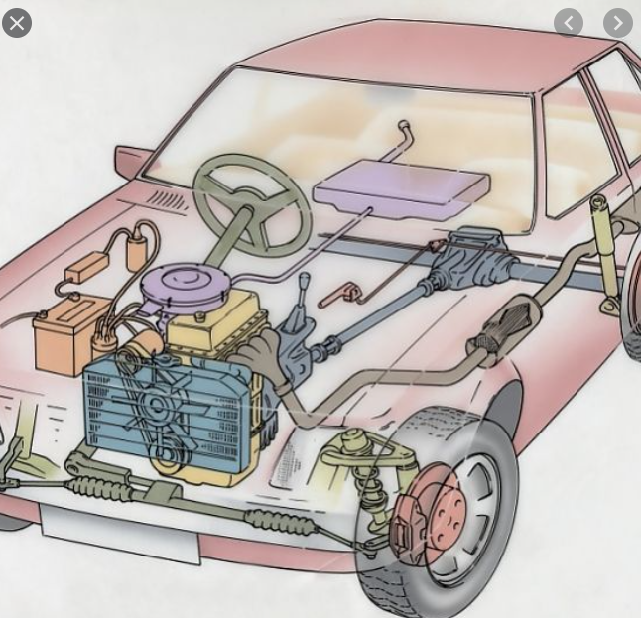
Week 3 cross sectional diagrams
Examples of cross sectional diagrams, you should be able to see what is inside the outer shell of the object.

Slide 42

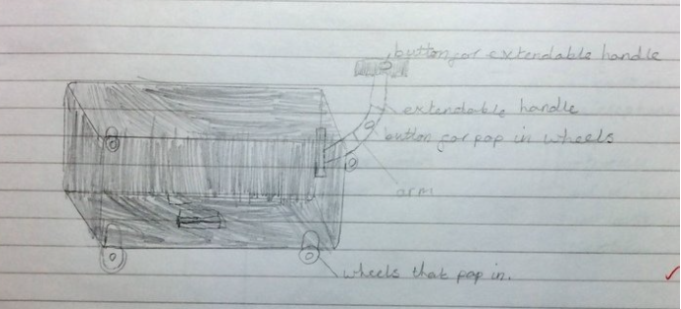
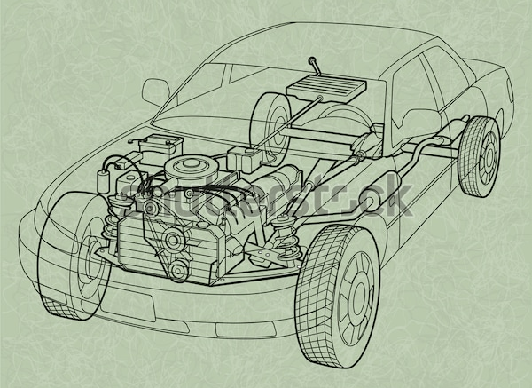
Cross sectional diagrams
Draw the outer shell of your vehicle lightly and shade with colour faintly. Inside draw where the components of your circuit will be placed and hidden, with labels.
This is a year 4 example from another school, at Park Spring we would include measurements and label the electronic components.

Slide 43
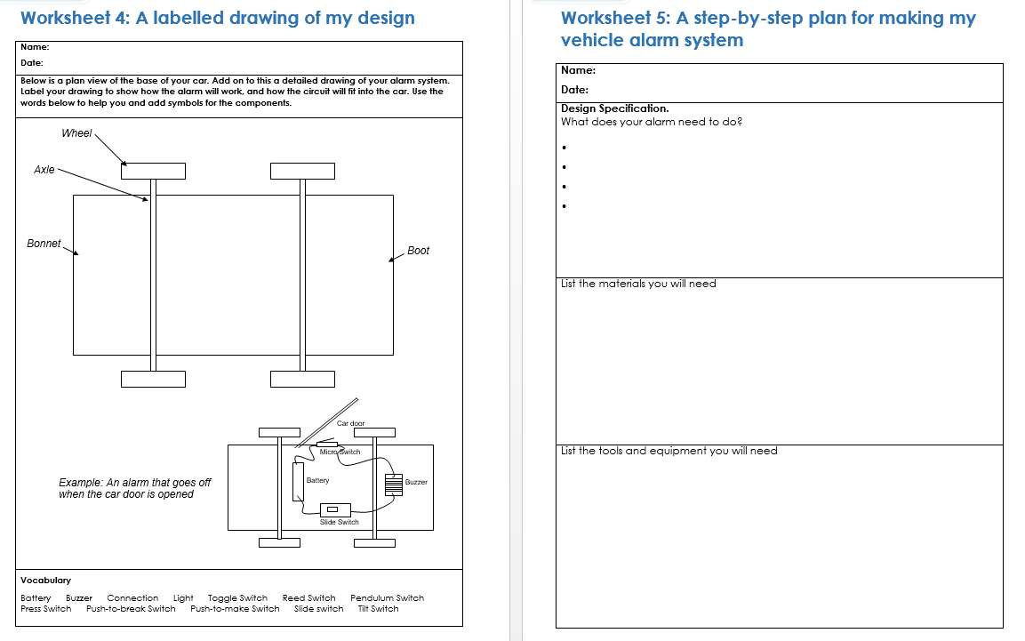

Slide 44
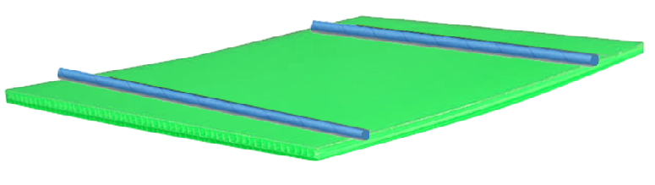
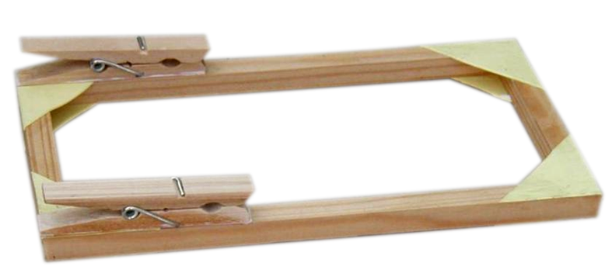
Making a vehicle
Make a step-by-step plan using worksheet 5.
Make sure the vehicle is large enough to hold the circuit and components.
The chassis
The main focus of this is the alarm system, so the chassis and body can be simple.
If you need a stronger frame you can use glued wooden strips, card corners and pegs to hold the axles.
Correx
Axles could be attached using thick straws or axle brackets.

Slide 45
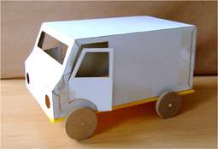
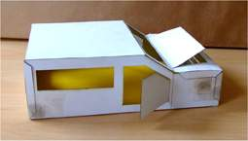
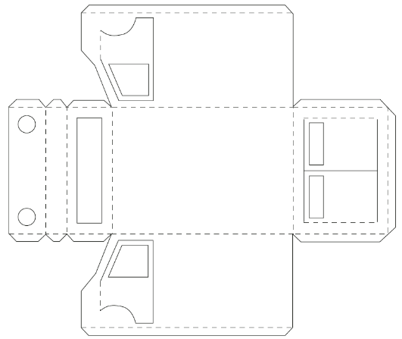


Making a vehicle
The body
See vehicle nets for a choice of vehicles that can be cut and folded to make the car body. They should have hinged doors, bonnets and boots.
You may need to reinforce opening doors that are going to be alarmed by using wood, lolly sticks and card.
Use triangulation to strengthen the structure if required.

Slide 46
Week 4
Add to the design – who the user will be… write the sentence stem onto the plan. I am creating an alarm system for a dumper truck therefore my user will need a large space at the back to store materials, large wheels etc.
Print nets onto card for the children to use. Model scoring lightly and cutting all the way through. Explain tabs and their function. We prob don’t have a class set so this could be done in small groups, but we do have metal rulers and Stanley knifes in the DT central store, so would be great to model safe use of these tools to ensure more precise cutting.

Slide 47


Slide 48


Slide 49


Slide 50


Slide 51


Slide 52

Open door example
An alarm to warn if a door is not closed correctly, or to warn if a thief tries to steal the car by opening the door.
An alarm will sound when the door is opened. The alarm
system is all hidden inside the car and not visible from the outside.

Slide 53


Pressure sensor example
Overloaded truck?
This push-to-make switch will trigger an alarm when the weight of the load becomes too great.
Push-to-make switch set into base of vehicle.
Foam blocks

Slide 54


Slide 55

Finishing your vehicle
Your circuit should be hidden from view so you may need to add some finishing touches to make sure it is concealed.
You will need access to the on-off switch.
Test the system to make sure it works as you planned it.

Slide 56
Let's complete the post assessment
One drive
Curriculum 2020
End of unit low stake quizzes
Year 6

