Slide 1
Year 4 multiplication tables check
Administered over a 3 week window during June.

Slide 2
What is the multiplication tables check?
All children in Year 4 will sit the Multiplication Tables Check (MTC) in June 2022. As a school, we can administer the check within a three week window from Monday 6th to Friday 24th June 2022. It is a statutory assessment.
It is an online assessment, designed to determine whether pupils can fluently recall their multiplication tables up to 12, through a set of 25 timed questions.
Knowing all tables to 12 is essential for your child’s future success in mathematics.
It will identify pupils who have not yet mastered this mathematical skill so school can provide additional support.

Slide 3
What does is consist of?
Your child will need to take a short online test to make sure their times tables knowledge is at the expected level.
There are 25 times tables questions (not including practice questions).
Your child will be able to answer 3 practice questions before taking the actual check.
They will then have 6 seconds to answer each question and be allowed a 3 second rest between each question. An on screen timer will count down the time for the children.
On average, the check should take no longer than 5 minutes to complete.

Slide 4
Do I need to do anything to prepare my child for the check?
Below are ways that you can practise at home.
Support your child in recalling their times tables to 12x12 in fun and engaging ways, such as creating games to support with learning or recalling them together whilst carrying out every day activities.
Times tables poster that your child will be bringing home.
TTRS – the soundcheck section is a close match to the multiplication table check.
Maths Frame – multiplication table check Multiplication Tables Check – Mathsframe this link takes you onto activities that mirrors the multiplication tables check.

Slide 5
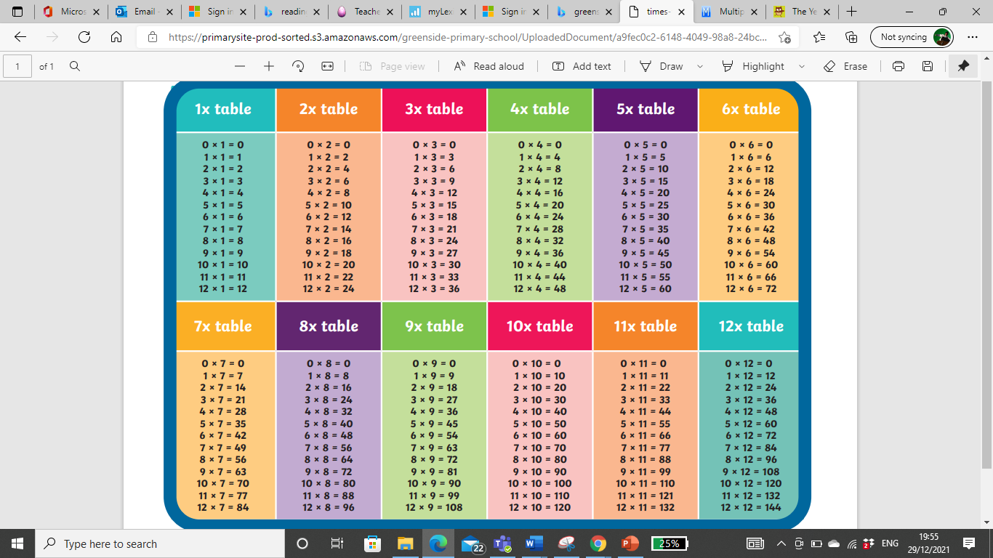
Times Tables Poster

Slide 6
TTRS – Soundcheck

Slide 7
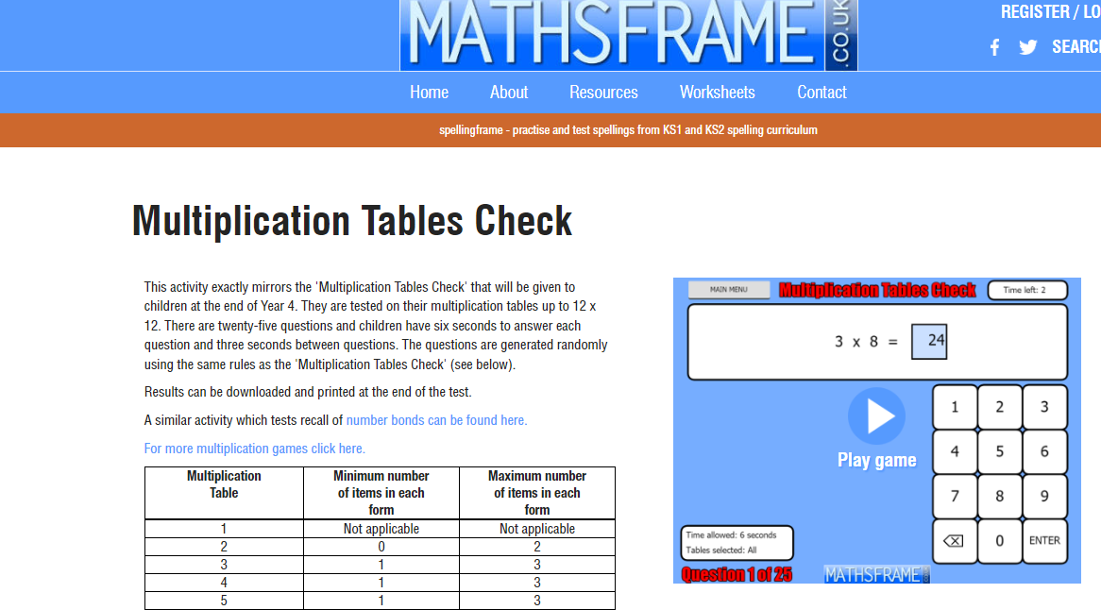
Maths Frame Multiplication Tables Check - Mathsframe

Slide 8
How will the results be used?
Data will not be published in league tables but will be available for staff to see how pupils have performed.
School will provide additional support for those pupils who need it.
You will receive your child’s score with their end of year report.

Slide 9
Top Tips
Focus on multiplication and ensure this is embedded.
Encourage your child to use TTRS regularly. Short but regular bursts will be most effective.
Ensure your child feels confident with the format of the multiplication table check by playing ‘soundcheck’ on TTRS.
Questions about the six, seven, eight, nine, and 12 times tables are likely to come up most often, as these are the hardest for most children to learn. It’s a good idea to focus on these tricky times tables with your child.
Make learning tables fun as this will have a much more effective outcome!

